Slide 1
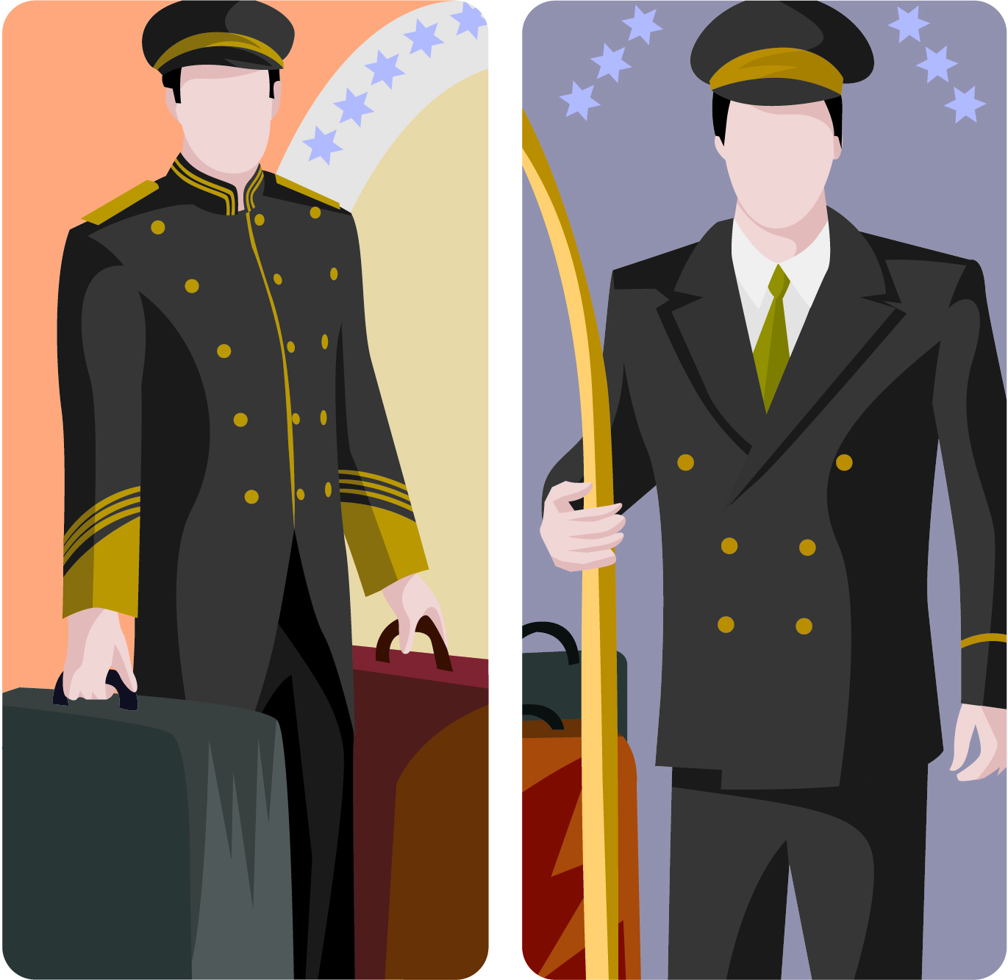
PROVIDE BELL BOY/PORTER SERVICES
D1.HFO.CL2.07
Notes:
Trainer welcomes trainees to class and informs them the unit titled “Provide Bell Boy/Porter Services”.

Slide 2
Subject Elements
Element 1: Identify the role of a bell boy/porter
Element 2: Assist with guest arrivals
Element 3: Assist with guest departures
Element 4: Assist other departments
Element 5: Provide concierge services
Notes:
Trainer briefs trainees the five subject elements.

Slide 3
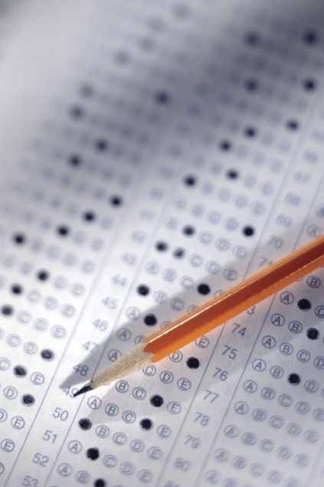
Assessment
Assessment for this unit may include:
Oral questions
Written questions
Work projects
Observation of practical skills
Practical exercises
Notes:
Trainer advises that assessment for this Unit may take several forms all of which are aimed at verifying they have achieved competency for the Unit as required.
Trainer indicates the methods of assessment that will be applied to them for this Unit.

Slide 4
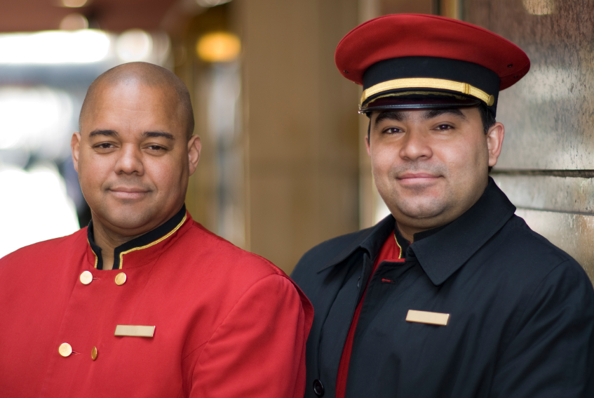
Element 1 - Identify the role of a bellboy or porter
Notes:
Trainer introduces Element 1 - Identify the role of a bellboy or porter.

Slide 5
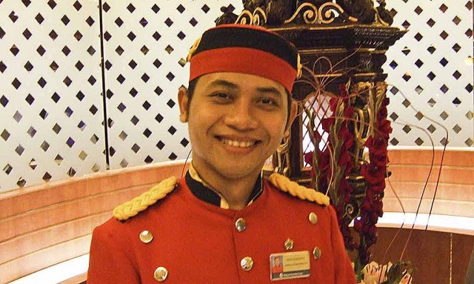
Porters are the people who
Greet guests as they arrive at the venue
Manage guests’ luggage
Provide general information services
Provide valet services (car parking)
Act as a central point of contact for groups
Are called uniformed staff because their uniforms are of military style and they are the only staff permitted to wear uniforms outside of the Hotel in working hours
Notes:
Porters’ duties include:
• Meeting and Greeting the guest, and assisting with luggage
• Rooming the Guest; showing them how their room operates, location of light switches, environmental controls
• Luggage management
• Marketing the areas of the Hotel or resort including in house businesses and services
• Taking messages or mail for in house guests.
• Solving guest’s problems and queries about local and recreational facilities.
In some venues staff are multi-skilled and cross-trained, meaning that several different jobs will be performed by the same person.
For example:
• the concierge and the porter can be the same person
doorperson duties may be shared by the porters or concierge person
Sometimes Porters share front desk duties and staff the reservations section.

Slide 6
Concierge department
Concierge
Porter
Door person
Guest Services
Desk
Valet parking
Chauffeur
Limo or Bus
Bell hops,
[gofers]
Groups
Notes:
Trainer to explain the Concierge department diagram.

Slide 7
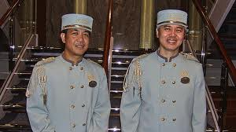
Presentation of a porter
To achieve a good first impression the porter must be:
Well presented
Friendly, welcoming, and courteous
Organised and efficient
Able to communicate clearly and accurately with guests
Notes:
The porter is often the first point of contact for the guest when arriving at an accommodation establishment.
It is therefore important for the porter to create a good first impression.
To achieve a good first impression the porter must be:
• well presented
• friendly, welcoming, and courteous
• organised and efficient
• able to communicate clearly and accurately with the guests.
A porters presentation will have a lasting impression on the guest and it is important that this impression be of the highest standard at all times.
Note the use of the words “at all times” –a porter must look as presentable five minutes before they finish, as they did when they started.
How staff stand and move reflects on the image of their personal presentation, be aware of posture, body language and the speed of movement.
A porter should move with dignity and purpose
Remember that a uniform, as well as personal grooming and deportment, completes the physical side of a porters professional and personal presentation.
Class discussion:
Consider what type of uniform is required?
How will it vary from location and star rating?

Slide 8

Les Clefs d’Or The Society of the Golden Keys
The name of the world renowned association for concierges & porters
Commitment to the professionalism of the concierge role
Demonstrate integrity and respect in the position
Notes:
As overlap in the roles of concierges and porters may often occur, take note of Les Clefs d’Or.
This society is a worldwide organisation of concierges. It was started in France in 1952 by the head porter of a large Parisian hotel with the aim of uniting all hotel porters in an association based on friendship, solidarity and fraternity.
Today, all around the world, the crossed keys are proudly worn on the lapels of concierges and their assistants.
Class activity
Why is a concierge who is a member of the Society of the Golden keys important to a Hotel’s prestige?

Slide 9
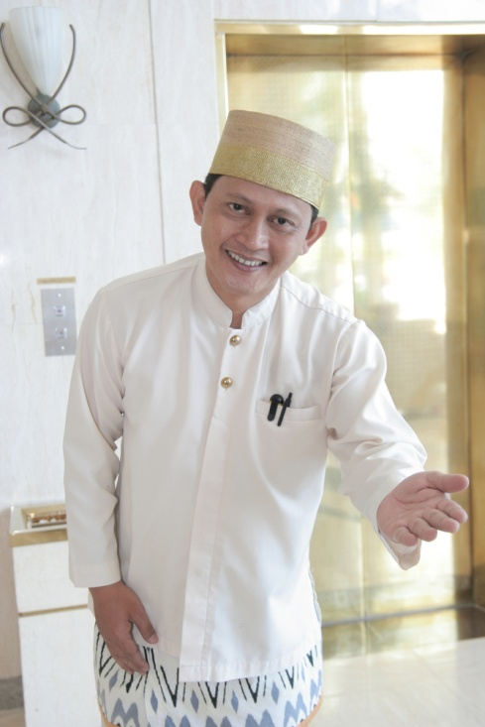
Appearance of Bell boy or Porter
Posture
Jewellery
Odour
Make-up
Hygiene
Hair
Hands
Uniform
Notes:
Porters interact with other departments and external businesses .
Arranging hire cars, booking transport or tours.
Booking tickets to the theaters, sporting venues or other entertainment
Confirming travel arrangements e.g. airline tickets.
Make restaurant reservations and bookings.
Deliver Mail and Messages
The Concierge may also be responsible for lobby security and driveway supervision
grooming standard expected may include:
• Good posture
• Basic jewellery
• Odour- Good dental health, Lightly-scented aftershave or perfume, Deodorant lightly scented
• Make-up is kept natural
• Hygiene, good personal hygiene habits, cuts and sores must be kept covered with a clean dressing.
• Hair; Clean shaven or whiskers neatly trimmed
• Hair neat and tidy and tied back, if appropriate
• Hands must be clean and well cared for at all times Manicured nails with natural coloured polish
• Clean and pressed uniform, low heel, polished shoes

Slide 10
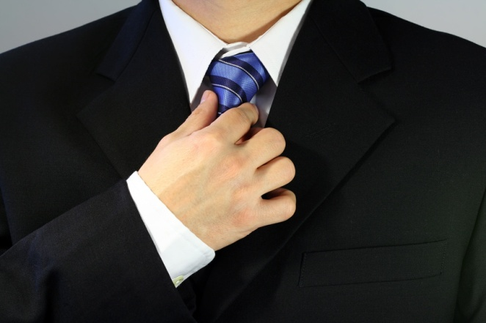
VIP Protocols
VIP ranking
Regular guests
Company executive
International Dignitaries
Celebrities
Royalty
Notes:
VIPs are often ranked and include:
regular guests, return guests will have rewards such as a fruit basket or upgrade
Home country government officials, heads of state, ministers , military leaders, etc
Company executive, CEOs or managing directors, board members and business tycoons or owners.
International or foreign dignitaries, heads of state, ministers , military leaders, etc
Celebrities, actors, performers, athletes, notables.
Titled people and Royalty.
There may be a policy and protocols for addressing and escorting VIPs to their rooms. There will established practice and processes and these guests may arrive with their own staff and large amounts of luggage.

Slide 11
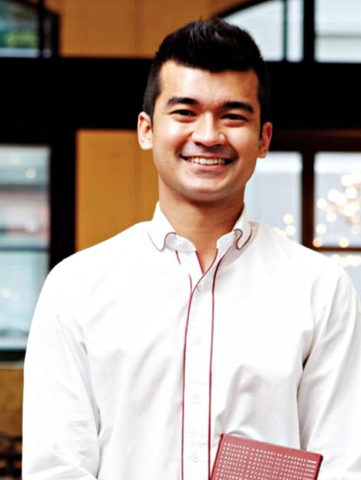
Communicating with guests
Good manners and etiquette are important to give an instant impression of respect
Porters conduct themselves in a professional manner
Act politely, show courtesy and correct etiquette
Notes:
The first impression of the establishment is often affected by the way the guest is greeted. the use of effective and appropriate non-verbal communication (body language).
It is critical that the message sent by the body language is in-keeping with the verbal message sent.
Class activity
Identify non-verbal gestures that could be used to direct guests to;
Greet the Guests
Through the front door
Reception desk to check in
Into the Lift or elevator.
Porters need to be well prepared and ready when greeting guests, able to give prompt and courteous service. Be aware of cultural and behavioural conventions including the use of honorifics and social etiquette.
establishing a relation and connection with the guest that is characterised by agreement and harmony.
To achieve these outcomes when communicating with the guest, the valet must always:
• conduct themselves in a professional manner
• act politely
• show courtesy
• demonstrate correct etiquette at all times: etiquette can be described as manners, decorum and propriety – etiquette is the set of customary rules for behaviour in polite society
• speak clearly and concisely
• use the guest’s name at all times
• be truthful at all times
• exhibit a constant willingness to assist.
Maintaining confidentiality is an absolute requirement for a valet: it is 100% non-negotiable.
• preparation for Very Important People (VIP) – which may involve the need for additional security, special gifts in the room, a guided tour of the property
Class activity
Meet and greet practical role play with students establishing how to greet guests from different cultural background commonly traveling to your area as tourist or business

Slide 12
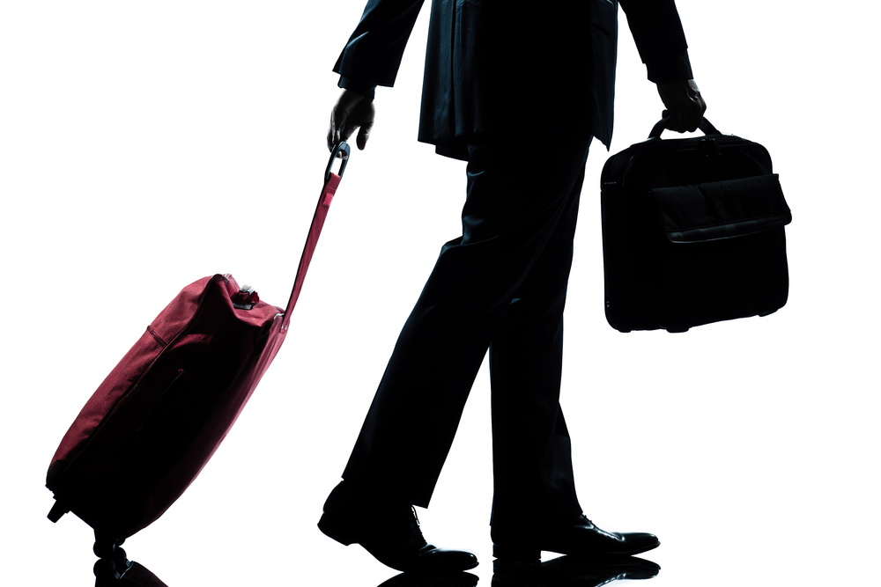
Element 2 - Assist with guest arrivals
Notes:
Trainer introduces Element 2 - Assist with guest arrivals.

Slide 13
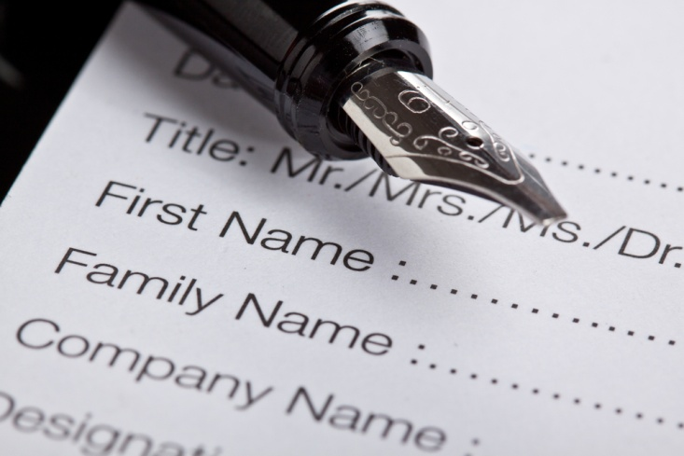
Pre arrival preparation - check
Expected arrivals
Arrival date and departure date
Estimated time of arrival (ETA)
Guest’s name
Number of guests
Room type
Room rate booking guaranteed or not
Special requests
Notes:
Accommodation establishments generally have an Arrivals List.
The Arrivals List provides information to many departments, one of which is uniformed Staff, where it assists the porter in efficiently completing his or her tasks.
Whether the Arrivals List is manually or computer generated, the information found on it must always be treated in the strictest of confidence and should never be left unattended for public viewing.
Information found on an Arrivals List may vary from establishment to establishment, but can be expected to include:
• arrival date
• departure date
• estimated time of arrival (ETA)
• estimated time of departure (ETD)
• guest’s name
• number of guests
• room type
• room rate
• booking guaranteed or not
• special requests.
The Arrivals List is a necessary tool in the planning undertaken to receive guests.
It helps to inform management and staff as follows:
• staffing Levels – determining the number of porters required to meet shift demands
• planning of daily tasks – identifying the busy versus quiet times
• prepare for group arrivals – such as tours
• preparation of special requests – which may include items such as preparing for guests with a physical disability, a request for champagne on arrival in the room, a fruit platter, or a cot in the room
• organising luggage storage areas – especially for large groups of guests who may be on a tour, or who have all come off a recently landed plane.

Slide 14
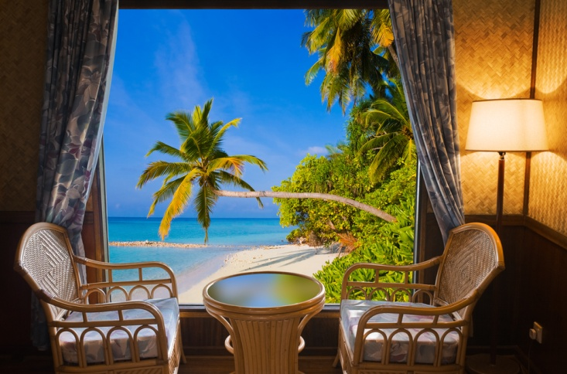
Arrange for and deliver special requests
Special requests may include:
Extra furniture or beds
Bed linen
Food and Beverage
Flowers and decorations
Notes:
The front office usually takes these special requests, with the original booking of the room or face-to-face with guests at check in or during their stay. The actual filling of these special requests requires a team effort and frequently it is the porter who is required to assist in ensuring special requests are fulfilled in accordance with requirements and establishment procedure and policies.
Use the internet to check the special requirements published for entertainment celebrities.

Slide 15
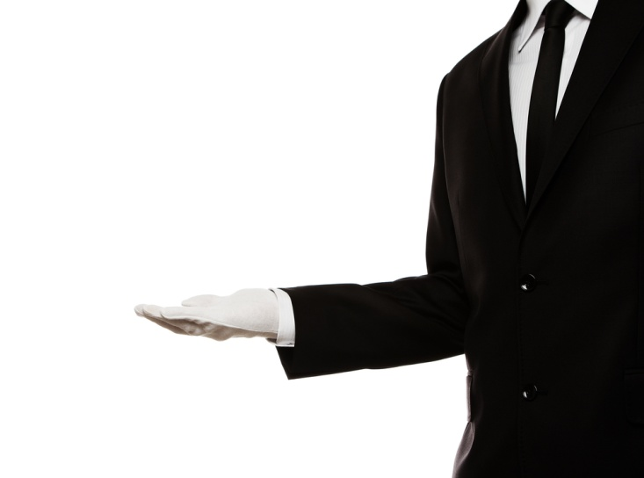
Greeting guests on arrival
The type of greeting the guest receives from the porter must always be:
Professional
Personable
Welcoming
Sincere
Friendly
Notes:
The porter should ensure every guest receives a welcoming and professional greeting when arriving at the establishment.
Remember that the porter is usually the first representative of the establishment who meets face-to-face with the guest and this meeting can therefore have a lasting impression.
The moment the porter identifies a guest, they should immediately acknowledge them and not wait for the guest to make the first move.
The type of greeting the guest receives from the porter must always be:
• professional
• personable
• welcoming
• sincere
• friendly.
In all instances, the verbal greeting/welcome offered must conform to any establishment policies or directives, but will generally contain:
• the establishment’s name
• the guest’s name or title if appropriate
• an offer of assistance.
The porter’s desk – or the “bell desk” as it is also known because it traditionally has a bell to summon portering staff – is usually strategically positioned in the lobby.
This is so the porter has a clear view of the entrance to enable them time to prepare themselves to greet guests, and so guests can also be seen by the reception staff in case they are needed: this arrangement also provides good security as a spin-off benefit.
Once the guests have been greeted, they should be directed to the reception area to register, as this is a legal requirement.
The porter will assist guests with their luggage and walk with them to the reception area. Once there, the porter should introduce the guest to the reception staff, if the guests’ names are known.
On other occasions, the porter will only guide the guests in the direction of the reception, while remaining at their post.

Slide 16
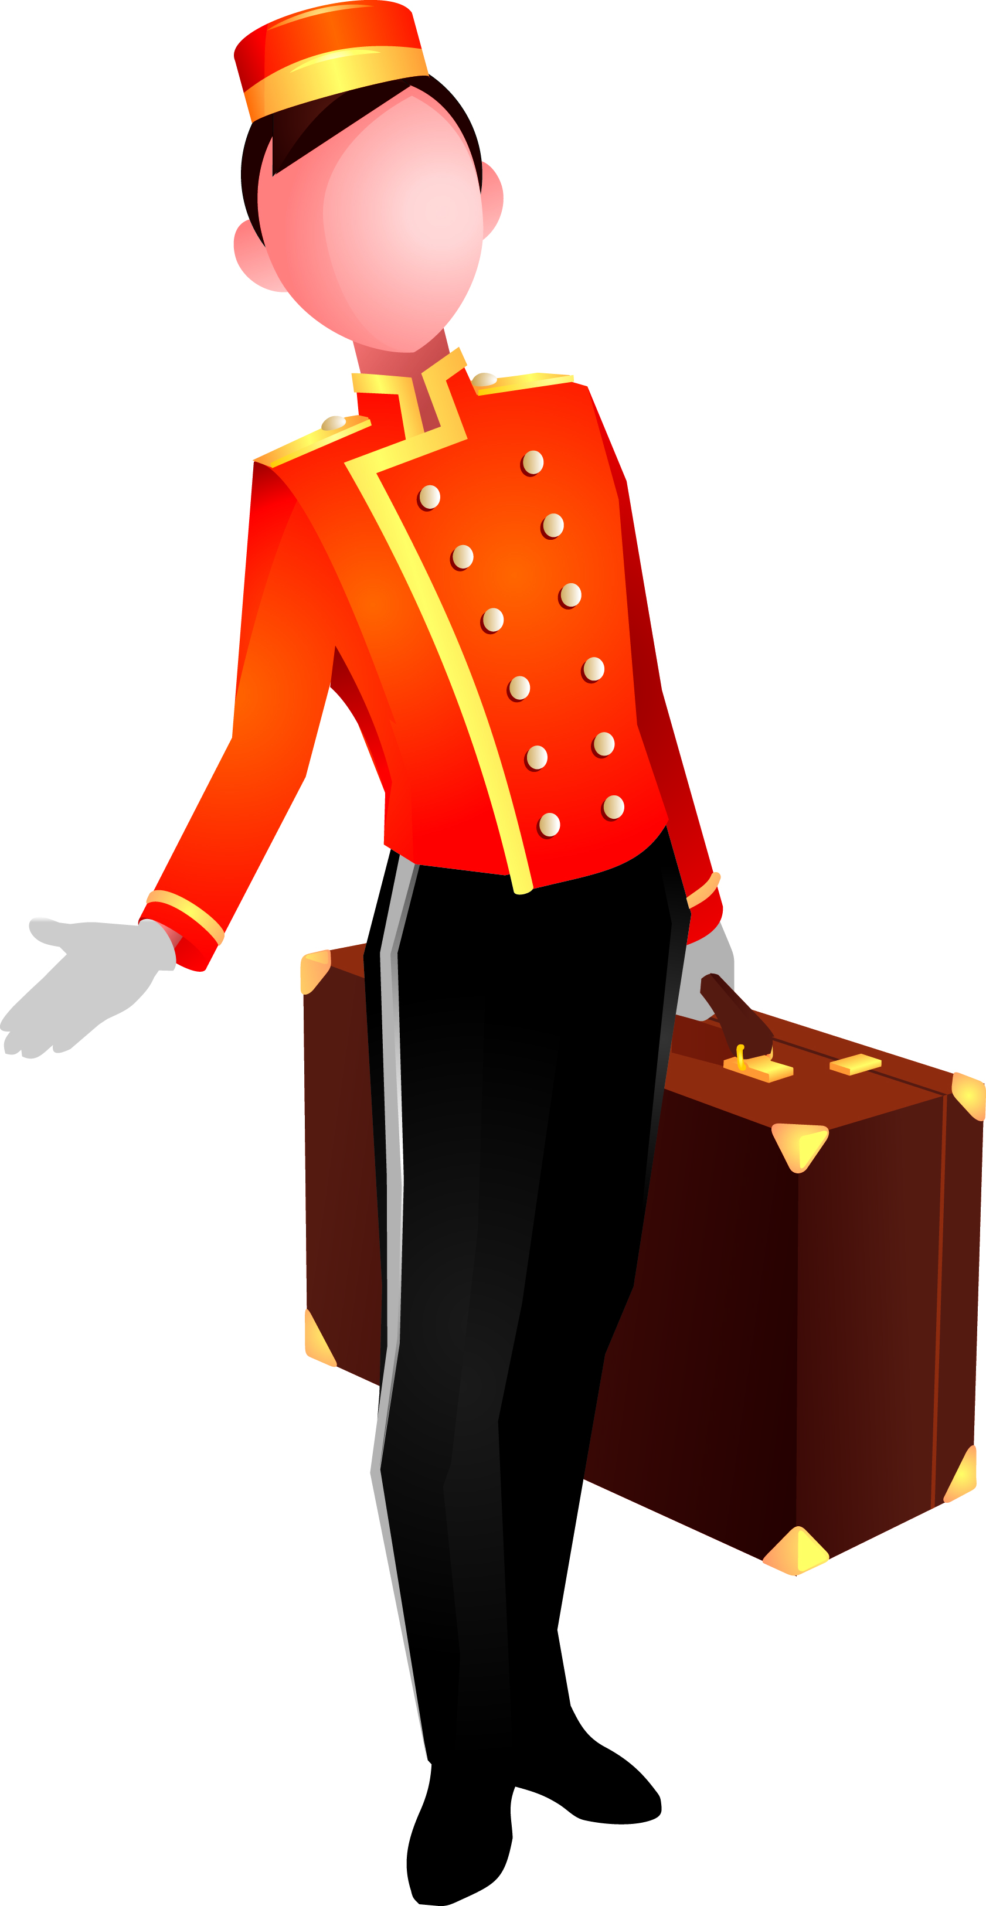
Escorting the guest
Rooming the guest:
Advise the guest of the venue’s emergency evacuation procedure
Answer any questions the guest may have
Highlight facilities and services available in the venue
Discuss upcoming events in the town
Notes:
Escorting guests to their rooms is an important role played by the porter.
It allows the porter time to:
• interact with the guest
• provide them with information about establishment facilities
• sell the restaurants, bars, spa, other hotel facilities
• provide details of tourist attractions, thus encouraging the guests to stay an extra night.
Once check-in has been completed, the porter receives the room key from the receptionist, collects guest luggage, and then escorts the guests to their room.
When escorting the guest to their room, remember to:
• speak clearly and concisely
• answer questions accurately, or inform the guest that you will seek out the answer and get back to them
• be courteous and polite
• never voice your opinions on issues unrelated to the establishment
• keep the conversation professional and on a positive note
• walk at a comfortable pace to suit the guest
• ascertain if this is the guest’s first time at the hotel or not: if it is, try to sell facilities of the property.

Slide 17
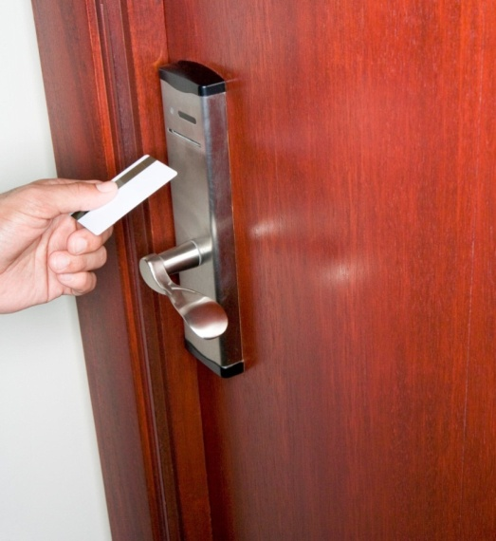
Escorting the guest
Explain key use
Point out room features
Notes:
Use the internet or YouTube to view room entry and different types of keys.
List room features:
Environmental control- heating and cooling
In house movies
Mini bar
Telephone
Compendium.

Slide 18
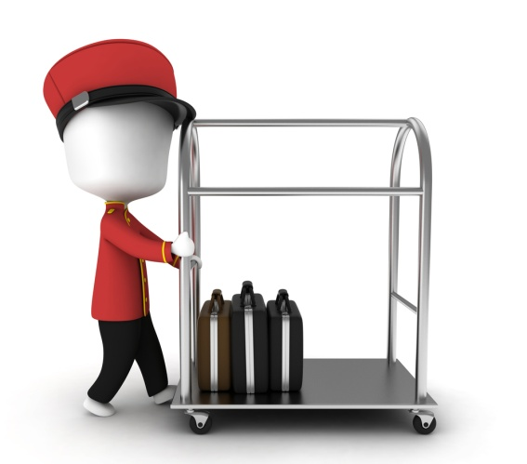
Loading the trolley
Safely – no damage
Securely – not stolen or misplaced
To the correct location
use of an appropriate route
Within acceptable time frame
Multi room delivery
Notes:
Throughout a shift there will be many times when the porter must assist guests with their luggage.
Luggage may have to be removed from the boot of a car or from the compartments in a tour bus. Luggage should also be treated as an item of great value and never be left unattended, particularly outside the hotel entrance.
Occupational Safety and Health; Luggage can be heavy – sometimes very, very, heavy – and therefore the porter must be aware of some basic occupational health and safety issues regarding handling luggage, including:
• test the weight of bags before lifting – give them a test lift
• adopt the correct posture for lifting
• keep the back straight
• bend the knees
• lift the luggage.
Use an approved trolley if luggage is too heavy to lift comfortably and correctly.
If more than one item is to be placed on the trolley, the heaviest bags should be placed on the bottom and the lighter ones near the top.
If an item is too heavy to pick up, the vertical trolley should be used as the porter will not have to personally lift the bags.
In some establishments, specific routes for the trolleyed transportation of guest luggage have been identified: these should be adhered to where they apply.
Likewise, some establishments have procedures for where certain luggage should be placed within rooms – articles on hangers may have to be hung up, suitcases to be put onto the appropriate racks, briefcases next to the bed, and so on: these must be adhered to with every guest in every room, unless the guest requests something else.

Slide 19
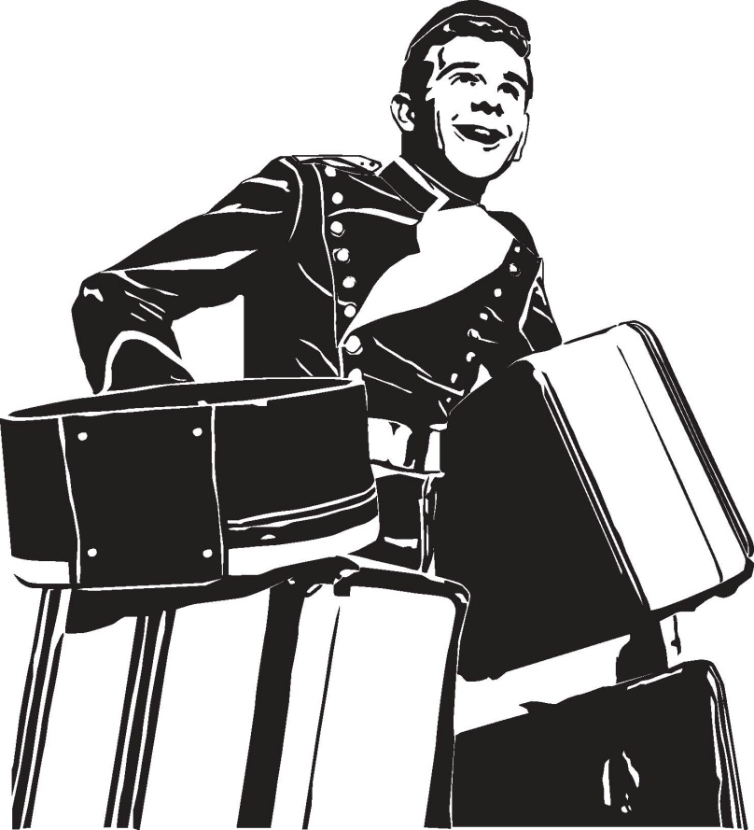
Element 3 - Assist with Guest departures
Notes:
Trainer introduces Element 3 - Assist with Guest departures.

Slide 20
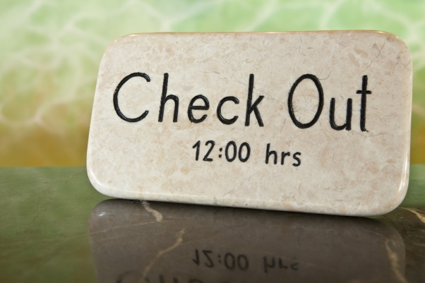
Guest Departure
On departure, the porter is likely to:
Collect luggage from the guests room
Collect the guest car
Arrange for other transport (if required)
Forward mail
Provide information
Provide directions
Notes:
When a guest is ready to check-out of their room, the porter will be required to assist the guest with their luggage.
The porter will usually be advised as to how much luggage has to be moved and the approximate weight of the luggage. A trolley may frequently be needed.
The porter should arrive at the room in plenty of time to ensure that guests achieve their stated aim – if there is one (such as catching a certain plane, being away by a certain time, etc): it must be remembered that guests can get very anxious at check-out too.
Upon arriving at the guest’s room, the porter should knock on the guest’s door and announce him or herself.
On being invited into the room, the porter should inquire as to the whereabouts of the luggage and the number of items, some will be quite obvious but some might be in the bedroom, the lounge or even the bathroom, also check for forgotten items. In some cases, where there are shops within the complex, guests may even want you stop by one of the shops to pick up a package..
Sometimes the guest will accompany the porter to the reception area, where the guest will check-out. The porter will then move the guest’s luggage to a private car, taxi, or tour bus.
On other occasions, the porter will be asked to take the luggage down to the reception area or storage area and the guest will check-out later.
In this case, the porter needs to tag the luggage and store it in the Porter’s Room or the Luggage Room. In some properties the room has bay numbers, eg, Bay One, Bay Two etc. and this number is recorded on the guest’s luggage tag for easy retrieval upon check-out.
The rules about transporting luggage – mentioned earlier – apply at this phase of the guest’s stay too.

Slide 21

Luggage tags
Luggage is often tagged with an identification label is attached to the handle of every piece of luggage.
The identification label will have written on it the guest’s full name and the room number
When tagging bags, always write the number of items being stored, belonging to that guest, on the tag
This is an important procedure so that guest’s luggage does not get lost
Notes:
Most accommodation establishments have luggage labels.
The tag will indicate:
• Whose luggage it is (guest name)
• Guests room number
• Group name (if appropriate)
• Number of pieces
• Type of luggage.
The porter should always use luggage labels to write the guest’s name and room number on as soon as this is known. The label should then be attached immediately to the guest’s luggage.
It is most important for the porter to ensure that all luggage is labelled accurately.
Sending the wrong luggage to the wrong room causes annoyance, poor guest relations, and embarrassment and has the potential to lead to theft, and breaches of privacy.
Luggage itself should never be actually marked.
Luggage should have a tag attached. This tag may be a two-part type where one-half of the tag is attached to the luggage, and the other portion is given to the guest for them to use when claiming the luggage.
Other tags simply register the name of the guest whose luggage it is, together with the total number of items stored: in some cases the guest is asked to provide an approximate time of pick-up so that the porter can determine where in the Luggage Room to physically store the items.
Some establishments utilise an alpha storage system whereby items are stored in alphabetical order (using the guest’s surname as the indicative letter); some will use a system based on given pick-up times.
Class activity
Design a luggage tag and role play with students greeting guests and filling out and attaching the tag to luggage items.

Slide 22
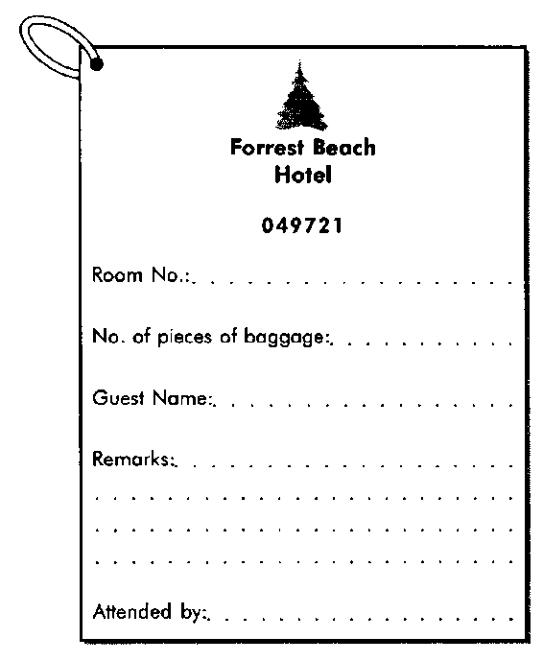
Luggage storage
Guests request luggage stored
Luggage tagged and stored in a secure area
Why do guests store luggage?
Notes:
In-house luggage storage systems vary between establishments, usually in terms of their size, location and documentation used.
Luggage storage systems (Luggage Rooms) are places where guests can store their luggage before they are roomed, or after they have departed their room.
In some cases, the guest may have arrived at, say 6am, only to find there is no vacant room: guests are still occupying them, and/or dirty rooms have not been cleaned and notified as “room ready”. In such cases, the establishment may register the guest (because they know a room will become vacant for them), offer them a free breakfast while they wait, and store their tagged luggage in the Luggage Room.
The first appropriate room that becomes vacant will be allocated to them, the porter notified, and the luggage delivered.
In another example, a guest may depart their room at 9.45am and be leaving town that evening at 6pm on a cruise: they may ask that their luggage is kept for them until 2pm to enable them to go and do some shopping before they pick it up and head off to the wharf.
The Luggage Room would be used for this type of safe storage.
• Enterprise procedures for storing items in the Luggage Room focus on security.
• Each item is tagged and contains the guest’s name and usually the total number of items lodged for storage.
• Some form of documentation – perhaps half of a tear-off slip – is given to the guest to facilitate the retrieval of the luggage.
• When the guest returns to collect their luggage they are required to provide identification before being supplied with their luggage.
• Where identification has been lost – management should be called immediately to resolve the problem.
• Luggage will be transported by porters as required – either to the room, or to the external pick-up area/car park.
At the time of arrival, a guest’s room may not be ready. To give the guest the freedom to leave the venue without the inconvenience of holding onto their luggage, the venue will store it for them.
Guest may not require some items in their Room, eg sporting equipment, Items not needed for this section of the guests journey
Conversely, at the time of departure, the guest may be required to vacate the room by 11.00 am but not due to leave the town until that evening. Again, the venue will store the guest’s luggage for them until required.

Slide 23
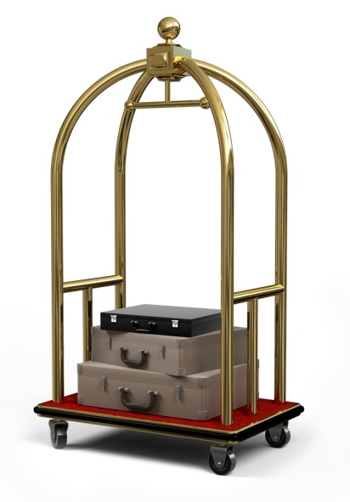
Groups
Arrival
Driveway accessibility of bus
Rooming list
Luggage unloaded.
Departure
Porters collect luggage
Ensure every piece is accounted for
Luggage is loaded
Notes:
Groups arrival
Bus arrives and luggage is unloaded and transported by the driver and/or porter to designated area (such as a special group check-in reception area)
• The porter counts and records the luggage on the group file
• Receptionist checks Rooming Lists and all relevant information for correctness and smooth check-in process
• Luggage is tagged by the porter
• Porter obtains Rooming List and places room numbers on tags
• Luggage is distributed to the different floors/rooms.
Groups departure
Shortly before the group’s departure, the porter collects luggage from rooms at allocated times (some hotels prefer luggage to be left outside the room for time saving reasons)
• Porters collect luggage
• Luggage is counted and checked against Rooming List to ensure every piece is accounted for
• Luggage is loaded onto the bus by porters.
Where a group is storing luggage, the marking and storing will take this into account – perhaps by using a colour-coded tag – this is not only a benefit to the guests but also speeds things up for porters when they are trying to identify appropriate luggage.
In some establishments, porters may be specifically tasked to deal with luggage from a group: they are dedicated to this task and, as such, can render more personal, thorough and careful service.
If a large group is checking out and there is not enough space in the Porter’s Room or Luggage Room, then the following three possibilities may apply:
• Luggage is placed in a hotel room (it is called a hospitality room). Some establishments will charge 50% of the room rate for such a service.
• Baggage is positioned in one corner of the lobby and it is roped off. A thick rope goes through all the handles on the luggage so that nothing can go missing.
• Baggage is positioned in one corner of the lobby and it is netted. This is when a large net, similar to a fishing net, is placed over the top of the luggage and secured tightly.

Slide 24

Element 4 - Assist other Departments
Notes:
Trainer introduces Element 4 - Assist other Departments.

Slide 25
Pre-arrival
Prepare the work area for the day, check expected arrivals and departures, delivering special requests to rooms
and booking and collecting tickets for special events
Departure
The porter is arranging luggage collection, coordinating transport and providing directions for guests
In House
The porter offers services to guests
and may perform a number of personal services
Arrival
Welcoming the guest,
collecting their luggage, direct guest to the registration desk and escort guest to their room
Notes:
Trainer explains the range of duties and interactions a porter has with a guest at all stages of the guest stay.
Revise the links with other departments.

Slide 26
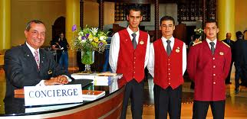
Inter departmental assistance
Duties supporting other departments
Security
Front office reception
Sales and marketing
Housekeeping – lost and found
Maintenance
Functions
Notes:
Porters may be asked to perform other duties, in departments short of staff for example room service need to clear a large number of trays or trolleys.
Security- For VIPs or to secure group luggage or other guest property
Front office reception- Guests special requests, reports & messages. Collecting guests tickets or Visas.
Sales and marketing- information and promotion of in-house services and special events
Housekeeping – lost and found, Room status, guest requests .
Maintenance – replacement light bulbs or other items.
Functions - in house events such as conferences.

Slide 27
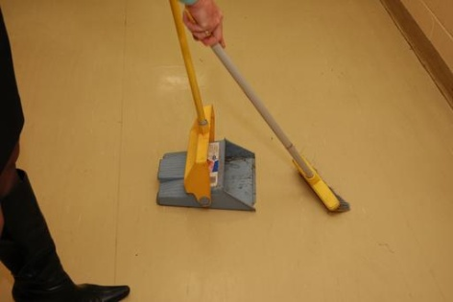
Emergency cleaning
Guests clothing is stained
Luggage exterior
Cleaning spills inside luggage
Lobby and driveway appearance
Notes:
Accidents leave clothing and other items stained and in need of cleaning.
The Hotel will keep contact details with specialist dry cleaners or fabric cleaners.
Some stains may be treated on site by Hotel staff for example Red wine spilt on a guests dress, or Chocolate or berry stains. If the guest has played a sport or participated in an outdoor activity Porters may have to clean a variety of dirt, mud or grass stains.
Hotel staff will have a reference resource on treatment of stains in an emergency.
Lobby and driveway appearance - cleaning soil tracked in by guests , smokers ash or liquid spills.

Slide 28
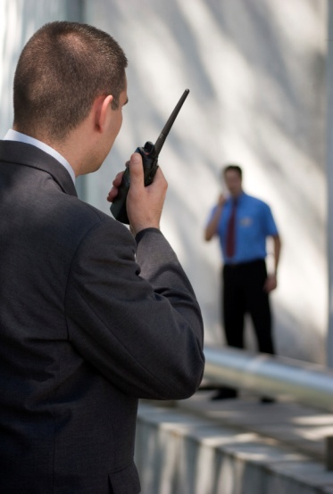
Emergency situations
Porters explain general emergency procedure to all guests when escorting them to their room.
Weather emergency
Guest has an accident
The guest is ill
The guest is involved in an incident
Notes:
The Hotel or resort would have staff trained in various levels of first aide and policies and procedures for staff to follow in case of emergency. Porters, in keeping a reference file of information to assist in responding to any guest requests, have an extensive list of medical professionals including specialists, dentists, doctors, chiropractors, physiotherapists, sports therapists and also culturally applicable medical service.
All incidents will be recorded and logged following the establishments policies and procedures.

Slide 29
Difficult guests
A disturbance is any incident which disrupts the normal activities of the establishment
Arguments
Altercations
Suspicious persons
Terrorist threats
Notes:
The porter may be required to assist when a disturbance does occur.
A disturbance is any incident that interrupts the normal activities of the venue.
It may include:
Guests who are having an argument or altercations
Suspicious persons people who are out of place or acting strangely
Terrorist threats such as bomb scares, gunfire or threats.
A porter needs to be constantly alert to people who seem ‘out of place’, uncomfortable or suspicious.

Slide 30
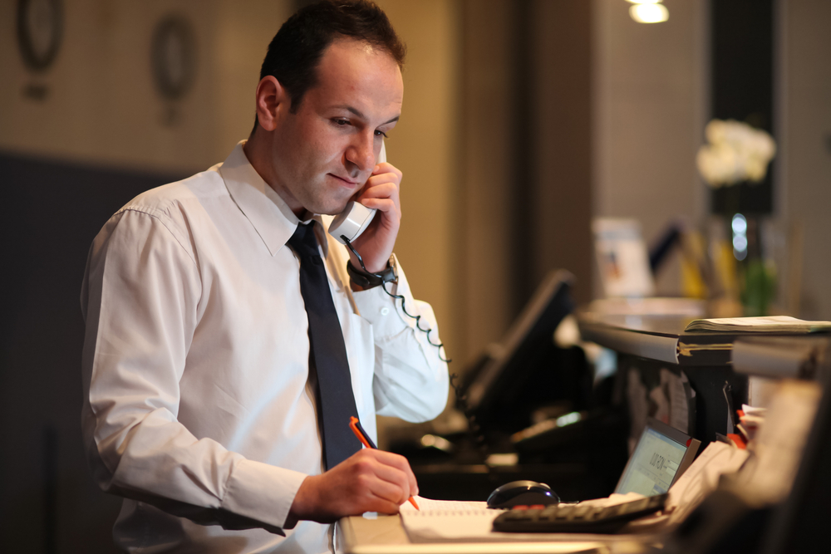
Element 5 - Provide Concierge services
Notes:
Trainer introduces Element 5 - Provide Concierge services.

Slide 31
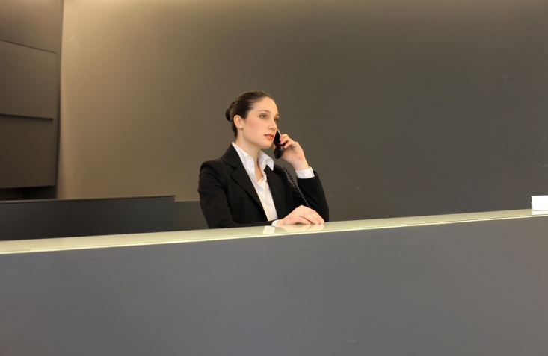
Provide Concierge services
Mail and messages
Hard copy
Electronic
Wake up calls
Logged with the telephonist
Automated
Personal
Notes:
Mail and messages types to be delivered include:
Snail mail, cards or promotional material, accounts,
Electronic accessible by the guest on the TV or telephone voice mail
Mail or messages may be received for:
Current guests
Future guests
Past guests.
For each there is a specific procedure to follow. All mail, parcels or messages must be time and date stamped and recorded in a mail received book.
Wake up calls
Depending on the Establishment ,The guest may prefer the option of having the wake-up call placed directly to the guest’s bedside phone, or the Butler or room service staff may take the wakeup call and personally knock on the guest’s door to awaken them usually with a morning service tray with a hot beverage or fruit juice.
Wake up calls can be organized through the Reception staff or the hotel telephonist who takes details of time and date of the request and at that time phones the guest s room to wake the guest up as this is a person to person call it may assist the wake up process if the guest explains the reason for the call for example a plane to catch or meeting to attend.
Some establishments have a direct computerized system wakeup call system. The guest logs the details of the wakeup call and an automated system rings and prompts the guest.
When booking a wakeup call the information should include the Guests name and room number, wake-up call time and sometimes purpose Include any snooze and recall times
Class activity
Create a wake up call sheet.

Slide 32
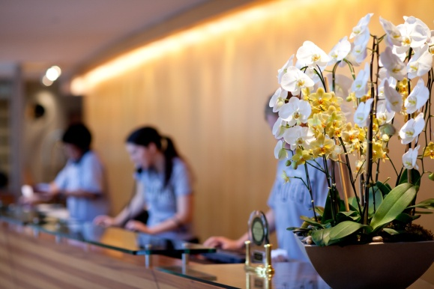
Provide Concierge services
Transport
Hire Cars and limousines
With drivers
Cycles and animal riding
Transfers for departing Guests information needed
The estimated time of departure the guest’s name and number of passengers
The number of pieces of luggage
Destination
Any special details, such as flight arrangements/rail details
Notes:
Transport include:
Hire cars
Limousines
Other local style transport such as cycles, taxis, carriages,
Riding on an animal – horses, donkeys, goats, elephants dolphins etc
Bus transport
Water transport such as water taxi, ferry, private hire.
Transfers for departing Guests
Whatever form of transport is arranged, certain information is needed:
the estimated time of departure of the guest;
the guest’s name and number of passengers. If children are included then booster seats, capsules or other requirements need to be considered;
the number of pieces of luggage;
destination;
any special details, such as flight arrangements/rail details.
Other information that may that may need to be taken into consideration include:
whether disabled/wheelchair access is required;
whether there is a large amount of luggage;
if there are large, cumbersome items to transport.

Slide 33
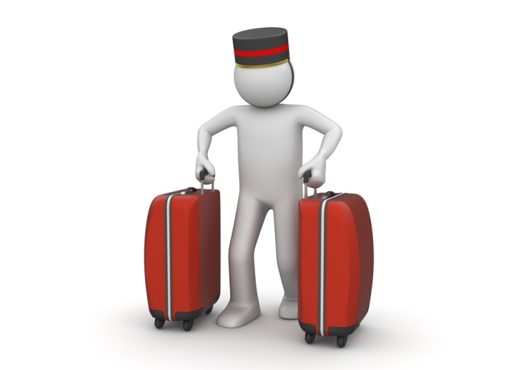
Provide Concierge services
Luggage pick up
Quantity
Location
Unaccompanied luggage
Paging Guests
Verbal
Electronic
Notes:
Luggage pick up
How much luggage there is and the type of luggage , there may be a need for more than one porter and trolley
Where is the luggage ? Guests room the guest may have luggage in storage or items to be collected from local vendors or customs agents if they have purchased an item that needs certification.
What time is the guest due to leave the hotel or resort as they may require luggage to be stored for a short time
Whether the luggage is to be loaded into a car or if commercial transport is to met.
Paging guests
Messages are still carried to guests in this way in some hotels especially those with historical or period themes
Currently messages are more likely to be forwarded by text to a mobile phone or accessed on an I Phone or notebook
Staff are also paged in this way to meet guest requests. With modern VOIP [Voice Over Internet Protocol] computer generated messages can be sent instantly, porters may use.

Slide 34

Porters Directory
A directory is an alphabetised reference book maintained by most porters and holds information about:
All the details about the facilities
Tourist attractions
Car hire, taxis and public transport options
Theatre and dinner bookings
Airline and other bookings
Advice on Local Knowledge
Notes:
Most porter’s desks maintain a directory. Usually maintained alphabetically, the directory gives the porter the information needed quickly and efficiently. It isn’t always convenient to ask a colleague the answer to a question or rely on memory. The directory contains information relating to places, costs, directions and service providers and a list of contacts and telephone numbers for those harder to get items
Local Knowledge
seasonal influences (eg, pilgrimage season, best times to see particular flora or fauna)
children’s parks tourist developments
natural heritage sites
local markets
museums.
Keep up-to-date with industry information so that you:
can give guests and junior team members information
know what is going on in your property and industry
promote products and services and help meet guest expectations

Slide 35

Conclusion
A Guest purchases more than just a room when they stay in a Hotel or Resort, they purchase intangible products for example security, comfort, luxury, service, and a feeling of importance. Good service will result in guests departing happy, content and relaxed
Porters duties are key to satisfied happy guests
Notes:
A Guest purchases more than just a room when they stay in a Hotel or Resort, they purchase intangible products for example security, comfort, luxury, service, and a feeling of importance.
Good service will result in guests departing happy, content and relaxed. Porters duties are key to satisfied happy guests.

Slide 36
Recommended YouTube videos
Building the job description - http://www.youtube.com/watch?v=-5hMmdHeegk&feature=related
Advice on becoming a Concierge in London - http://www.youtube.com/watch?v=KLWPCMVFTLE&feature=related
**The importance of the concierge - http://www.youtube.com/watch?v=QidGsXUqFC8&feature=related
***Ritz Carlton in Berlin - http://www.youtube.com/watch?v=qZNhgzzEJMY&feature=endscreen&NR=1
Notes:
Trainer to recommend YouTube videos for trainees to view.
Trainer thanks trainees for their attention and concludes the unit.

